Slide 1
B+ Tree
‹#›

Slide 2
YouTube Links
B Trees and B+ Trees. How they are useful in Databases - Abdul Bari
https://www.youtube.com/watch?v=aZjYr87r1b8
B+ Tree Intro and Insertion - Jenny’s Lecture
https://youtu.be/DqcZLulVJ0M
B+ Tree Deletion – Jenny’s Lecture
https://youtu.be/pGOdeCpuwpI
‹#›

Slide 3
B+ Trees
What are B+ Trees used for
What is a B+ Tree
Searching
Insertion
Deletion

Slide 4
What are B+ Trees Used For?
When we store data in a table in a DBMS we want
Fast lookup by primary key
Ability to add/remove records on the fly
Sequential access to records (physically sorted by primary key on disk)

Slide 5
What is a B+ Tree?
A variation of B trees in which
internal nodes contain only search keys (no data)
Leaf nodes contain pointers to data records
Data records are in sorted order by the search key
All leaves are at the same depth
Notes:
‹#›
The properties of B-Trees (and the trees themselves) are a bit more complex than previous structures we’ve looked at.
Here’s a big, gnarly list; we’ll go one step at a time.
The maximum branching factor, as we said, is M (tunable for a given tree).
The root has between 2 and M children or at most L keys.
(L is another parameter)
These restrictions will be different for the root than for other nodes.

Slide 6
Difference in B+ Tree and B Tree
B+ TREE | B TREE
Only leaf nodes have data pointers. | All internal and leaf nodes have data pointers.
Duplicate of keys are maintained and all nodes are present at leaf. | No duplicate of keys is maintained in the tree.
Insertion is easier and the results are always the same. | Insertion takes more time and it is not predictable sometimes.
Deletion of any node is (relatively) easy because all node are found at leaf. | Deletion of internal node is very complex and tree has to undergo lot of transformations.
Leaf nodes are stored as structural linked list. | Leaf nodes are not stored as structural linked list.
Redundant search keys may be present. | No redundant search keys are present.
Searching is (relatively) fast, since branching factor is high. | Searching is (relatively) slow.
‹#›

Slide 7
Definition of a B+Tree
A B+ tree is a balanced tree in which every path from the root of the tree to a leaf is of the same length, and each non-leaf node of the tree has between [M/2] and [M] children, where n is fixed for a particular tree.

Slide 8
B+ Tree Nodes
Internal node
Pointer (Key, NodePointer)*M-1 in each node
First i keys are currently in use
k₀
k₁
…
k_{i-1}
__
…
__
0
1
i-1
M - 2
Leaf
(Key, DataPointer)* L in each node
first j Keys currently in use
k₀
k₁
…
k_{j-1}
__
…
__
0
1
L-1
Data for k₀
Data for k₂
Data for k_{j-1}
Notes:
‹#›
FIX M-I to M-I-1!!
Alright, before we look at any examples, let’s look at what the node structure looks like.
Internal nodes are arrays of pointers to children interspersed with search keys.
Why must they be arrays rather than linked lists?
Because we want contiguous memory!
If the node has just I+1 children, it has I search keys, and M-I empty entries.
A leaf looks similar (I’ll use green for leaves), and has similar properties.
Why are these different?
Because internal nodes need subtrees-1 keys.

Slide 9
Example
B+ Tree with M = 4
Often, leaf nodes linked together
10
40
3
15
20
30
50
1
2
10
11
12
20
25
26
40
42
3
5
6
9
15
17
30
32
33
36
50
60
70
Notes:
‹#›
This is just an example B-tree. Notice that it has 24 entries with a depth of only 2.
A BST would be 4 deep.
Notice also that the leaves are at the same level in the tree. I’ll use integers as both key and data, but we all know that that could as well be different data at the bottom, right?

Slide 10
Advantages of B+ tree usage for databases
keeps keys in sorted order for sequential traversing
uses a hierarchical index to minimize the number of disk reads
uses partially full blocks to speed insertions and deletions
keeps the index balanced with a recursive algorithm
In addition, a B+ tree minimizes waste by making sure the interior nodes are at least half full.
A B+ tree can handle an arbitrary number of insertions and deletions.

Slide 11
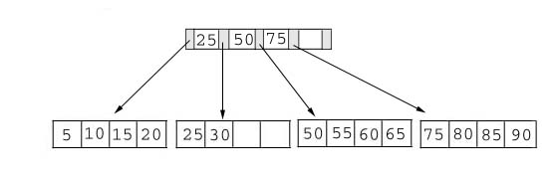
Searching
Just compare the key value with the data in the tree, then return the result.
For example: find the value 45, and 15 in below tree.

Slide 12
Searching
Result:
For the value of 45, not found.
For the value of 15, return the position where the pointer located.

Slide 13
Insertion
inserting a value into a B+ tree may unbalance the tree, so rearrange the tree if needed.
Example #1: insert 28 into the below tree.
25 28 30
Fits inside the leaf

Slide 14
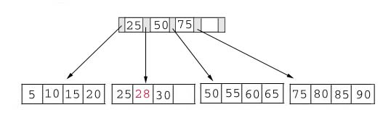
Insertion
Result:

Slide 15
Insertion
Example #2: insert 70 into below tree

Slide 16

Insertion
Process: split the leaf and propagate middle key up the tree
50 55 60 65 70
Does not fit inside the leaf
50 55
60 65 70

Slide 17
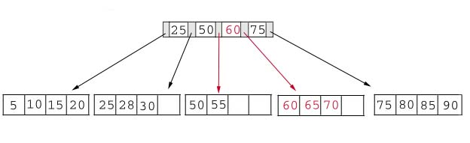
Insertion
Result: chose the middle key 60, and place it in the index page between 50 and 75.

Slide 18
Insertion
Leaf Node Full | Index Node Full | Action
NO | NO | Place the record in sorted position in the appropriate leaf page
YES | NO | Split the leaf node Place Middle Key in the index node in sorted order. Left leaf node contains records with keys below the middle key. Right leaf node contains records with keys equal to or greater than the middle key.
YES | YES | Split the leaf node. Records with keys < middle key go to the left leaf node. Records with keys >= middle key go to the right leaf node. Split the index node. Keys < middle key go to the left index node. Keys > middle key go to the right index node. The middle key goes to the next (higher level) index node. IF the next level index node is full, continue splitting the index nodes.

Slide 19
Insertion
Exercise: add a key value 95 to the below tree.
75 80 85 90 95
Leaf node full, split the leaf.
75 80
85 90 95
25 50 60 75 85
Notes:
Add 95 to 75, 80, 85, 90; node full. Split into: 75, 80 and 85, 90 95. Propagate middle value (85) to parent.
Parent is full with 25, 50, 60, 75. Split into 25, 50 and 60, 75, 85. Propagate middle value (60) up the tree.
‹#›

Slide 20
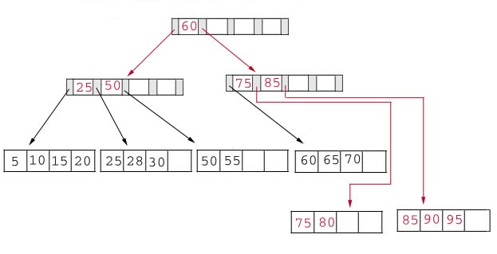
Insertion
Result: again put the middle key 60 to the index page and rearrange the tree.
Notes:
B+ Trees grow UP from the bottom
‹#›

Slide 21
Deletion
Same as insertion, the tree has to be rebuilt if the deletion result violate the rule of B+ tree.
Example #1: delete 70 from the tree
OK. Node >=50% full
60 65
Notes:
‹#›

Slide 22
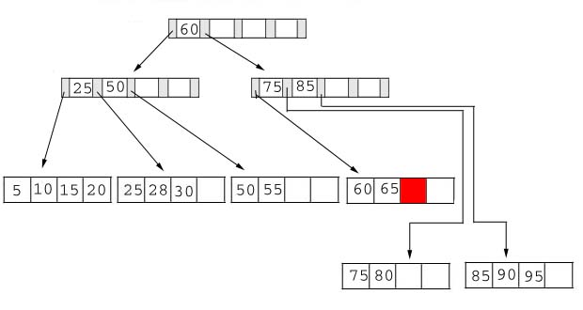
Deletion
Result:
Notes:
Locate it in the leaf node. Delete it. Node is still >= 50% full, all done.
‹#›

Slide 23
Deletion
Example #2: delete 25 from below tree, but 25 appears in the index page.
But…
28 30
This is OK.
Notes:
Locate 25 in leaf. Delete it. Node still >= 50% full so okay.
BUT, 25 was used in index node….
Propagate smallest value in leaf node (28) up the tree to replace it.
‹#›

Slide 24
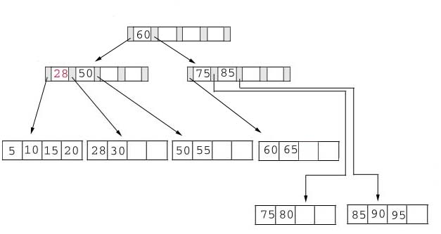
Deletion
Result: replace 28 in the index page.
Add 28

Slide 25
Deletion
Example #3: delete 60 from the below tree
65
Less than 50% full
50 55 65
Notes:
Locate 60 in leaf node Delete it. Leaf now < 50% full.
Neighbor at most 50% full, so merge with neighbor to the right. Guaranteed to fit.
‹#›

Slide 26
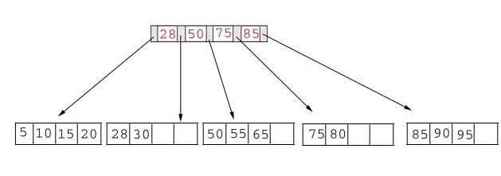
Deletion
Result: delete 60 from the index page and combine the rest of index pages.

Slide 27
Deletion
Data Page Below Fill Factor | Index Page Below Fill Factor | Action
NO | NO | Delete the record from the leaf page. Arrange keys in ascending order to fill void. If the key of the deleted record appears in the index page, use the next key to replace it.
YES | NO | Combine the leaf page and its sibling. Adjust the index page to reflect the change.
YES | YES | Combine the leaf page and its sibling. Adjust the index page to reflect the change. Combine the index page with its sibling. Continue combining index pages until you reach a page with the correct fill factor or you reach the root page.

Slide 28
Conclusion
For a B+ Tree:
It is “easy” to maintain its balance
Insert/Deletion complexity O(logM/2)
The searching time is shorter than most of other types of trees because branching factor is high.

Slide 29
End.
‹#›

